Slide 1
Deep Learning-Based Cyberbullying Detection Using Multi-Transformer Ensemble Architecture
Presented By
Amena Khatun
ID: 315201011
&
Shadat Mojumder Sazzad
ID: 315212007
Supervised By
Tahmid Rahman
Lecturer
Department of CSE
Hamdard University Bangladesh

Slide 2
Index
Introduction
Literature Review
Research Gap
Research Objectives
Contributions
Dataset Description
Proposed Methodology
Results
Conclusion and Future work
Reference
1

Slide 3
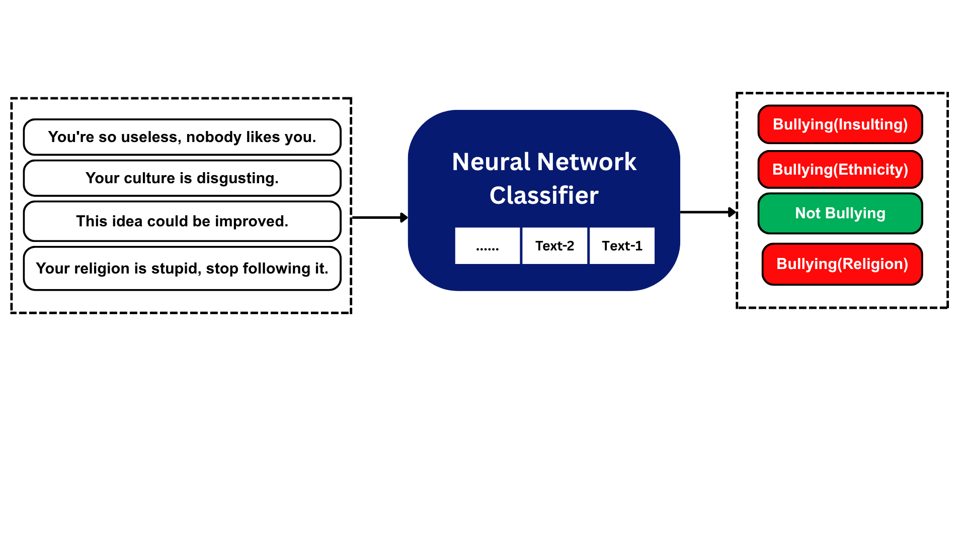
Introduction
Cyberbullying on social media causes serious psychological and social harm by hurtful comments, videos, and messages.
It leads to significant mental, emotional, and social harm, resulting in stress, anxiety, and reduced self-confidence.
Traditional ML models fail to capture deep contextual meaning to detect cyberbullying.
Figure-1:Cyberbullying Detection Using Neural Network Classifier
2

Slide 4
Literature Review
Sr. | Paper Title | Year | Method Used | Results | Limitations
1 | Cyberbullying Detection on Social Media Platform | 2021 | NLP Preprocessing ML Models(Naïve Bayes , Logistic Regression, SVM, Random Forest) | Random Forest (Facebook – 87.01%), Logistic Regression (Twitter – 78.62%). | Limited Dataset Data imbalance Context misunderstanding Low accuracy
2 | Deep Learning Algorithms for Cyber-Bulling Detection in Social Media Platforms | 2024 | LSTM-based Sequential Model Implemented in Keras (TensorFlow) ReLU+Sigmoid activation Adam optimizer | Instagram: 95.49%, Facebook: 91.42% | Text-only, English dataset, imbalanced data. Limited context No real-time or explainable AI
3 | Assessing Text Classification Methods for Cyberbullying Detection on Social Media Platforms | 2025 | BERT RoBERTa XLNet | BERT: 94 % RoBERTa: 93 % XLNet: 93% | Heavily dependent on labeled data computationally expensive. Less effective on small datasets.
3

Slide 5
Research Gap
The single transformer model can not achieve the higher accuracy than the multi transformer ensemble model.
Collecting a larger dataset is challenging, and imbalanced data can reduce recall and hurt the model’s ability to generalize well.
Existing LSTM and RNN are powerful for sequential modeling but often function as black-boxes, lacking faithful interpretability and structured attribution of hidden-state dynamics.
4

Slide 6
Research Objectives
To develop a robust multi-transformer ensemble framework that overcomes limitations of current models by achieving superior contextual understanding by combining deep embeddings and ensemble learning for better accuracy and generalization.
5

Slide 7
Contributions
A single model performs slightly lower, whereas the multi-transformer ensemble model achieves better accuracy, especially for complex, sarcastic or coded language.
Achieved the highest accuracy by using this BERT-RoBERTa Ensemble.
Successfully utilized balancing techniques on the 47K+ dataset to address imbalance, securing high Recall and robust generalization.
Designed a user-friendly interface for actionable insights from the system.
6

Slide 8
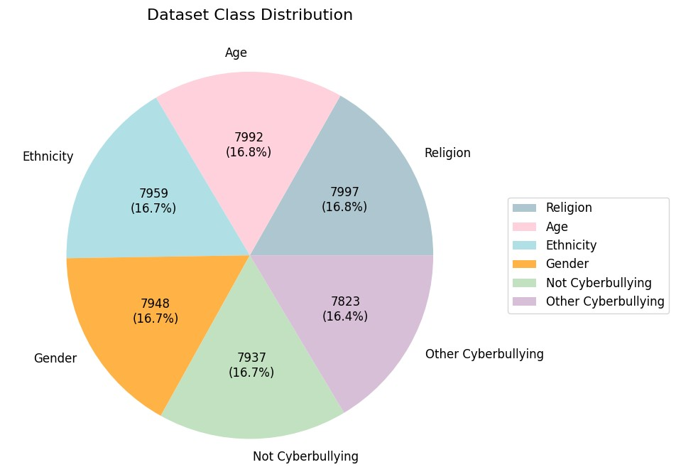
Dataset Description
Table-2:Dataset Description and Class Distribution
Info. | Details
Total Data | 47,656
Classes | Religion, Age, Ethnicity, Gender, Not Cyberbullying, Other Cyberbullying
Source | Social media platforms (Twitter, Facebook)
Data Type | Text (English)
Average Text Length | 136 characters / 23.7 words
Remarks | Multiple cyberbullying categories; Suitable for analysis and modeling.
Figure: Distribution of Tweets in the Dataset Classes
7

Slide 9
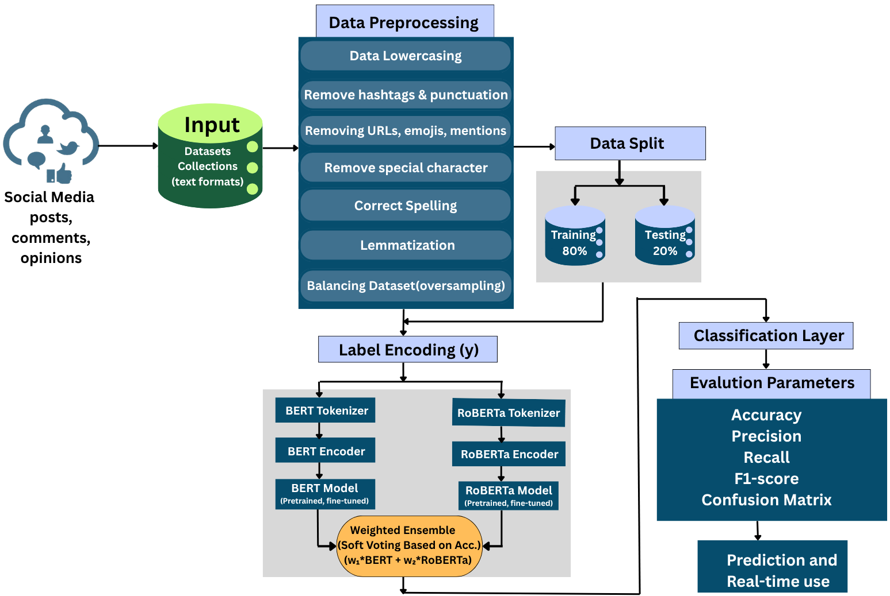
Proposed Methodology
Figure:Proposed System Workflow
8

Slide 10
Proposed Methodology
Step-1:Data Acquisition & Preprocessing
      Data Collection
      Cleaning & Normalization
      Balancing
Step-2:Model Training and Fine-Tuning
      Data Split(Train 80%, Test 20%)
      Tokenize text for BERT & RoBERTa
      Load & fine-tune BERT and RoBERTa individually
Step-3: Ensemble Models
      Get probability scores from BERT and RoBERTa
      Weighted soft voting:
      Final = w1*BERT + w2*RoBERTa
      Use Softmax to predict Bully vs Non-Bully
Step-4:Evaluation & Deployment
      Evaluate with Accuracy, Precision, Recall,
      F1-score, Confusion Matrix
      Deploy model for real-time social media monitoring
9

Slide 11
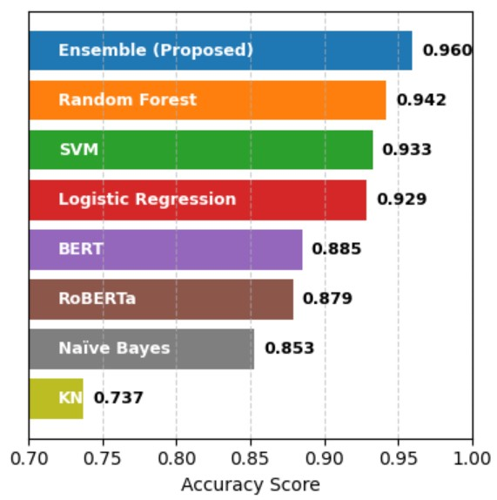
Results
TABLE -3:Comparison between proposed model and previous studies in terms of accuracy results.
Method | Precision | Recall | F1-score | Accuracy
Random Forest | 0.94 | 0.94 | 0.94 | 0.942
SVM | 0.93 | 0.92 | 0.92 | 0.933
Logistic Regression | 0.93 | 0.92 | 0.92 | 0.929
Naive Bayes | 0.86 | 0.86 | 0.84 | 0.853
KNN | 0.80 | 0.68 | 0.69 | 0.737
BERT | 0.89 | 0.89 | 0.89 | 0.9522
RoBERTa | 0.88 | 0.88 | 0.88 | 0.9491
Proposed Model | 0.95 | 0.95 | 0.95 | 0.96
Figure: Comparison. of Models Accuracy Performance.
10

Slide 12
Conclusion and Future work
Conclusion:
The BERT abd RoBERTa ensemble shows strong cyberbullying detection performance.
Delivers real-time, explainable predictions.
User-friendly and scalable for large social platforms, improving online safety.
Future Work:
Extend to multimodal data (images/videos)
Fine-tune multilingual transformers (mBERT, XLM-R) for cross-language and code-mixed text.
Integrate social network analysis for better context.
Improve real-time performance and deployment efficiency.
Add adaptive learning to handle evolving language.
11

Slide 13
References
[1]. M. M. Islam et al., “Cyberbullying detection on social media platform: Machine learning based approach,” [Journal Name], 2021.
[2]. M. H. Obaida, S. M. Elkaffas, and S. K. Guirguis, “Deep learning algorithms for cyber-bullying detection in social media platforms,” IEEE Access, vol. 12, pp. 65321–65335, May 2024, doi: 10.1109/ACCESS.2024.3406595.
[3].A. G. Philipo, D. S. Sarwatt, J. Ding, M. Daneshmand, and H. Ning, “Assessing Text Classification Methods for Cyberbullying Detection on Social Media Platforms,” IEEE Trans. Inf. Forensics Security, vol. 20, pp. 7602–7616, Jul. 2025, doi: 10.1109/TIFS.2025.3588728
[4]. F. R. Sayed, E. H. Elnashar, and F. A. Omara,“Cyberbullying detection in social media using natural language processing,”Scientific African, vol. —, no. —, e02713, 2025, doi: 10.1016/j.sciaf.2025.e02713.
12

Slide 14
Thank You
13

Slide 15
Aims and Objectives
Apply advanced Transformer-based models (BERT/RoBERTa) for rich semantic understanding.
Utilize ensemble fusion techniques to maximize accuracy and minimize prediction variance.
Construct a balanced, diverse dataset to mitigate bias and and handle small or limited datasets..
Support protection through alerts, content warnings, and automatic filtering of harmful posts.
14

Slide 16
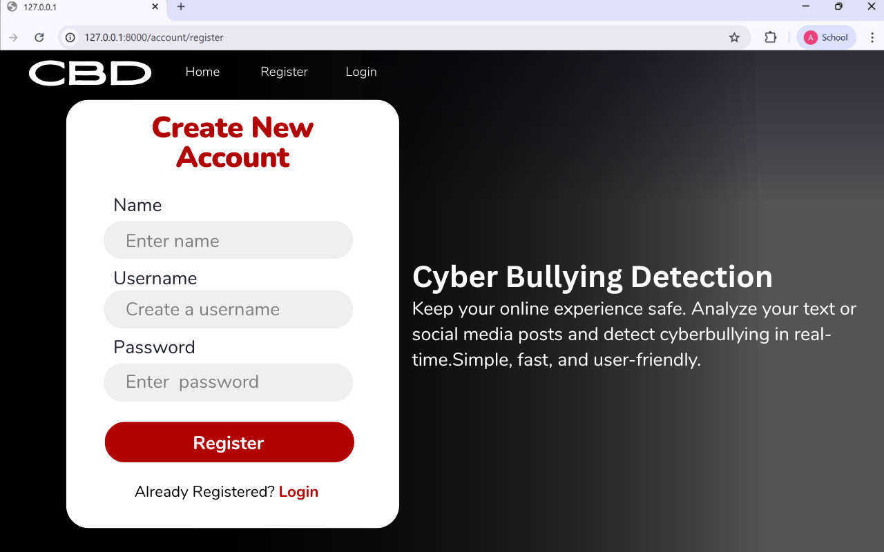
Interface
Our Interface link

Slide 17
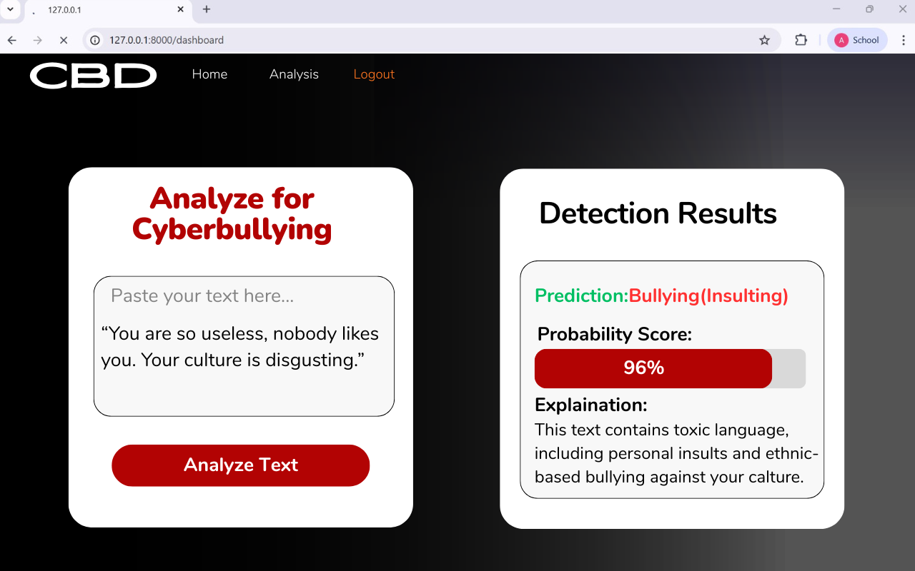
Interface

